Slide 1
Thonis-Heracleion
Ava Valentino

Slide 2
Legend
Aboukir Bay (Abu Qir)
500 BC
Series of Nile delta island port cities
Ancient writings of Herodotus and Strabo
Port city before Alexandria
Notes:
East of Canopis coastal town
15 miles NE of Alexandria
writings: temple, port at the mouth of the Nile
Gate to Egyptians for greek ships

Slide 3
Discovery
Franck Goddio, Frenchman and IEASM team
1996 research, excavations in 2000, Aboukir Bay
Electromagnetic dragging technology; nuclear magnetic resonance magnetometer
Temple of Amun and Herakles
Evidence of dock
Intense trade
Ptolemaic Kingdom
Notes:
IEASM – European Institute for Underwater Archaeology
Mathematician, statistician, Passions prompted change , Excavation permit, Pioneer of modern underwater archaeology
2.5k years old
Hero Herakles
Trojan War – Helen’s visit with love Paris

Slide 6
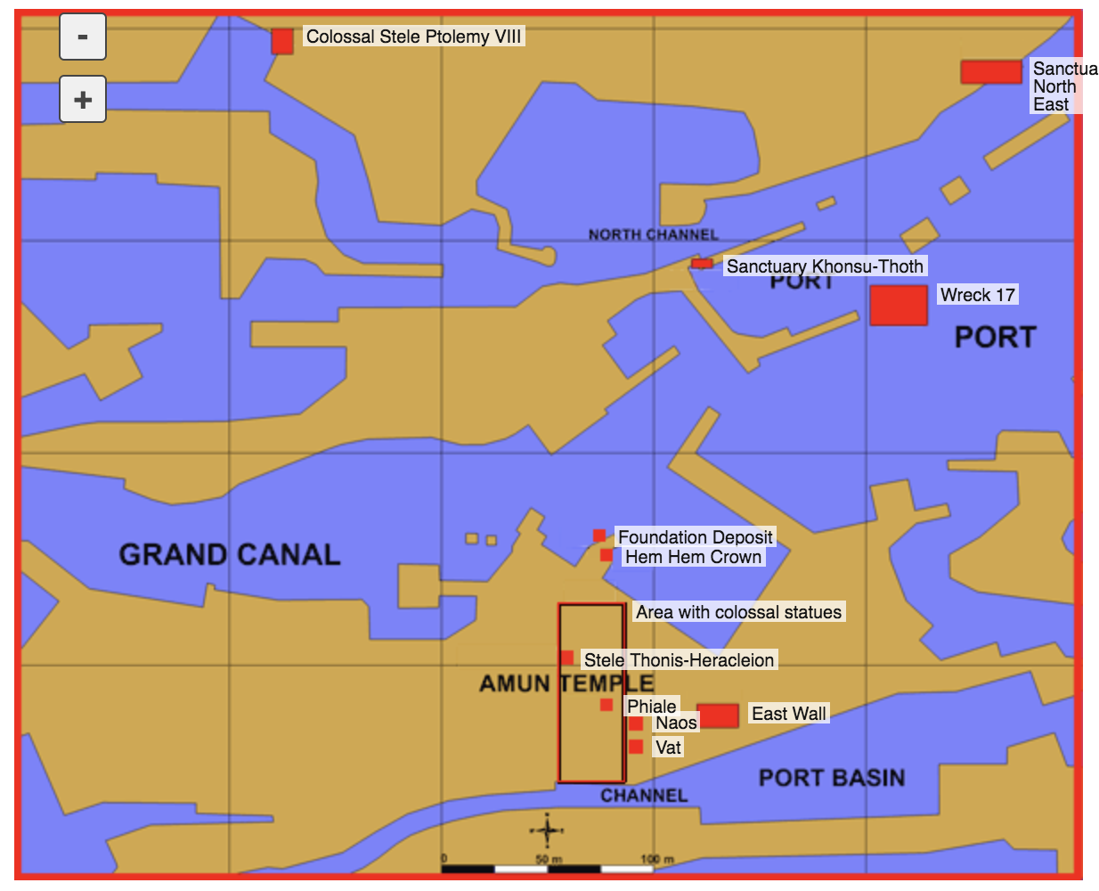

Slide 8
Importance
Underwater archaeology
Preservation
Ancient shipbuilding technology
Egyptian Maritime trade
Understand Thonis-Heracleion culture, unanswered questions
http://www.franckgoddio.org/projects/sunken-civilizations/heracleion.html
Notes:
Why sunk? – built on sand and water, area was sinking, earthquake and or tsunami final blow 7th century

Slide 9
Works Cited
Archaeologist, Franck Goddio-Underwater. FRANCK GODDIO SOCIETY Homepage. http://www.franckgoddio.org/http://www.franckgoddio.org/projects/sunken-civilizations/heracleion.html. Accessed 1 Mar. 2018.
Shenker, Jack. “Lost Cities #6: How Thonis-Heracleion Resurfaced after 1,000 Years under Water.” The Guardian, 15 Aug. 2016, http://www.theguardian.com/cities/2016/aug/15/lost-cities-6-thonis-heracleion-egypt-sunken-sea.
Sunken Ancient Egyptian City Discovered - Documentary - YouTube. https://www.youtube.com/watch?v=19Iea0kn31I. Accessed 1 Mar. 2018.

